Slide 1
PhoneGap and Xamarin: Your Excuse to Not Write Your Mobile App is Gone
Jerrel Blankenship & Jamie Dicken

Slide 2
Who We Are
Jerrel Blankenship
@TheJerrel
Software Engineer at RelayHealth
Author: Pro Agile .NET Development with Scrum
Striving Software Craftsman
Certified Scrum Master
Jamie Dicken
@DotNetGeekette
Software developer and team lead at McKesson-RelayHealth
Mobile enthusiast
Volunteer at Per Scholas

Slide 3

I Only Want To Write It Once

Slide 4
Frameworks To The Rescue
PhoneGap
Xamarin
AppMobi
Unity
Appcelerator
Adobe Flex

Slide 5
PhoneGap

Slide 6
What Is PhoneGap?
Open-source
Single codebase
Support for iOS, Android, Windows Phone, Blackberry, webOS

Slide 7
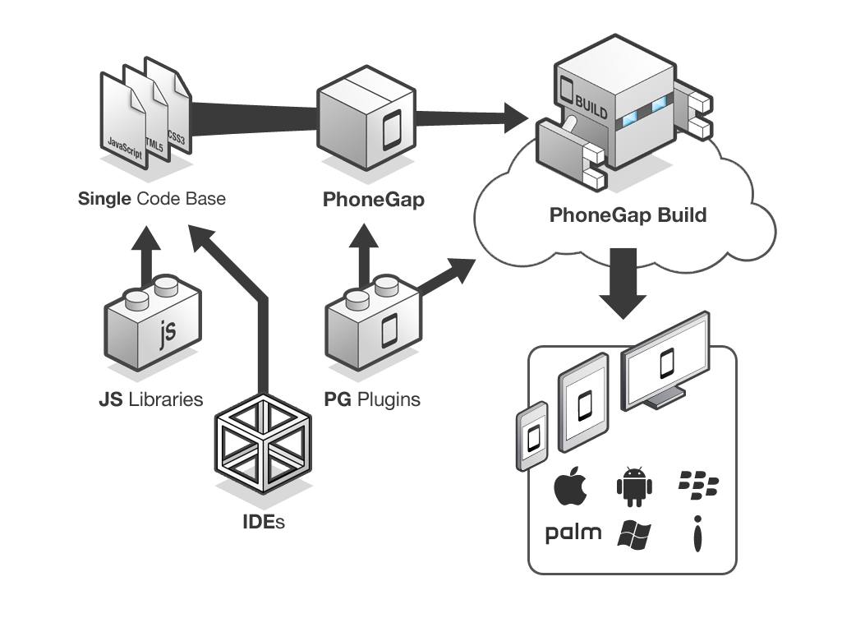
PhoneGap Overview
Notes:
Essentially, this is what the PhoneGap application creation process looks like. You take your IDE of choice as well as the javascript libraries you know and love, like jQuery mobile. You create one codebase, thereby eliminating the maintenance nightmares we face with redundant codebases. You wrap your html, css, and javascript files with PhoneGap, and you can take advantage of the PhoneGap plugins that interact with your device’s capabilities, like the camera and geolocation services. You send your app to PhoneGap build, and you end up with ready-to-submit app packages for each of the target platforms.

Slide 8
Let’s Create an App!

Slide 9
Xamarin

Slide 10
Xamarin Details
Cross-platform development with C#
Create native apps using Native APIs
Use any existing .NET Libraries
Notes:
Can develop Android and iOS apps
iOS requires network connection to Mac
Compiled code
Visual Studio Integration

Slide 11
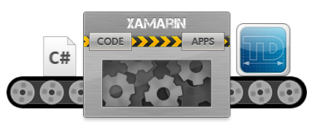

Slide 12
Code Time

Slide 13
PhoneGap v. Xamarin: Which do I choose?
Notes:
Jamie: Now that we’ve shown you two tools for cross-platform mobile development, the question becomes “which one should I use?”
Jerrel: Clearly, both of these tools allow you to easily create an app to deploy to all of the major app stores, so it really comes down to what you’re trying to accomplish.
Jamie: Let’s take a look at the advantages and disadvantages of each.

Slide 14
Key Considerations
Cost
Performance
Supported platforms
Native app experience

Slide 15
Questions?
Notes:
Jamie: Well, there you have it – two very different tools for creating cross-platform mobile applications. One leverages your web skills of HTML, CSS, and Javascript. The other allows you a cleaner way to have a different user interface per platform, easily making your apps seem much more targeted per environment and therefore enhancing the user experience.
Jerrel: And with that, your excuse to not write your mobile app is gone!

Slide 16


Slide 17
Contact Us
Jerrel Blankenship
Jerrel@jerrelblankenship.com
@TheJerrel
www.jerrelblankenship.com
Jamie Dicken
Jamie@dotnetgeekette.com
@DotNetGeekette
www.dotnetgeekette.com
Slide Deck Link:
http://bit.ly/16wOVaP

Slide 18
Image Attributions
Diagram - PhoneGap Overview by Adobe / Yohei Shimomae
Diagram - PhoneGap Build by Adobe / Yohei Shimomae
Smart Phone, Tablet, and PC – The Droid Guy

